Slide 1
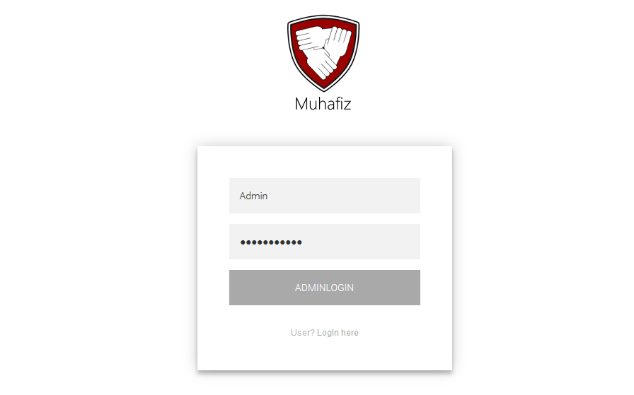
Admin Login
View: AdminLogin.cshtml
HomeController .cs handles all the Login/Registration Requests. Method Behind AdminLogin form Post is AdminLogin
Admin.cs Model class is managing databases queries.

Slide 2
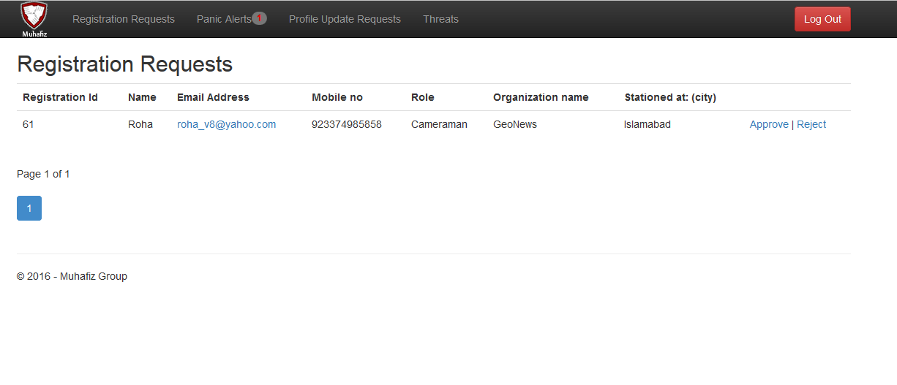
Registration Requests
View: Index.cshtml
AdminController.cs handles all admin actions e.g here is the view of Registration requests being displayed to Admin from User. Admin Perform two actions Approve Request here or Reject it.
Actions: Action behind that View is Index , on Approve Action Approve , on Reject Action Reject handles these in AdminController.cs.
Model: cperson.cs model class is coupled with this view.

Slide 3
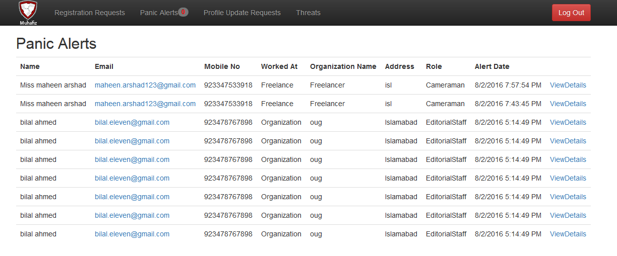
Panic Alerts
View: PanicAlert.cs html
AdminController.cs: Displays all the coming up PanicAlerts from dataabase.
Action: PanicAlert Action handle this.
Model. PanicAlertViewModel.cs html is coupled with this view
And PanicAlertViewModel.cs contains cperson .cs object and PanicAlert.cs object.

Slide 4
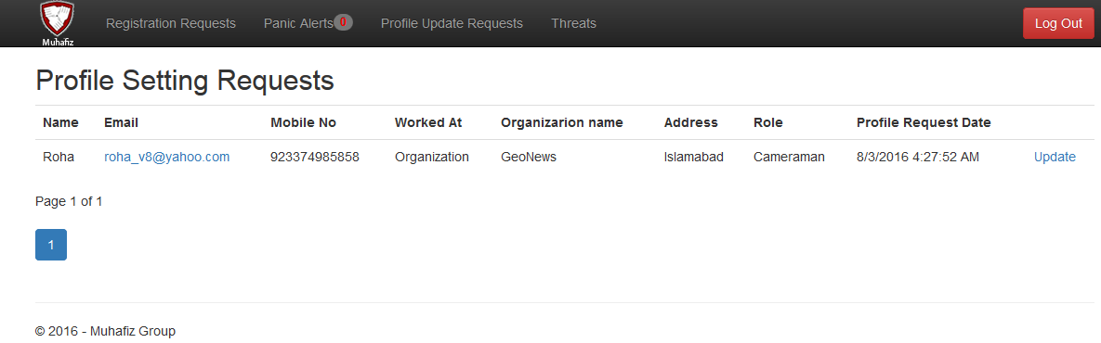
Profile Update Requests
View: InfoUpdateRequest.cshtml
AdminController.cs: Action InfoUpdateRequest returns list of Profile Update Requests of Users
Model: ProfileSettingViewModel.cs coupled with this view which inlcudes cperson.cs object, UpdateInfo.cs object.

Slide 5
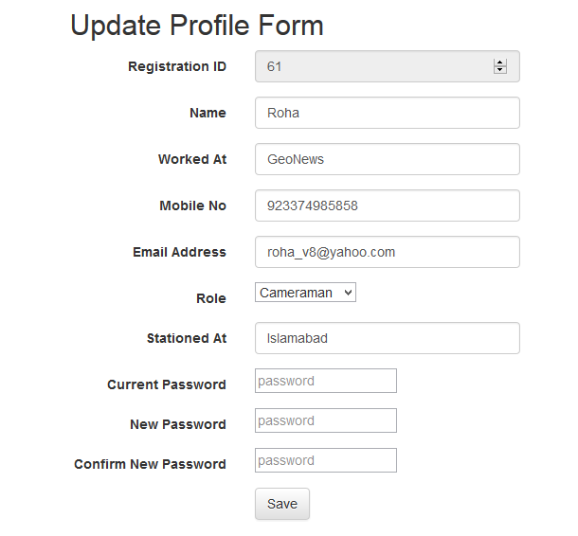
InformationUpdate Form
View: UpdateInfo.cshtml
AdminController: UpdateInfo Action handle this,e.g Update Entries of User.
Model: cperson.cs class is coupled with this view

Slide 6
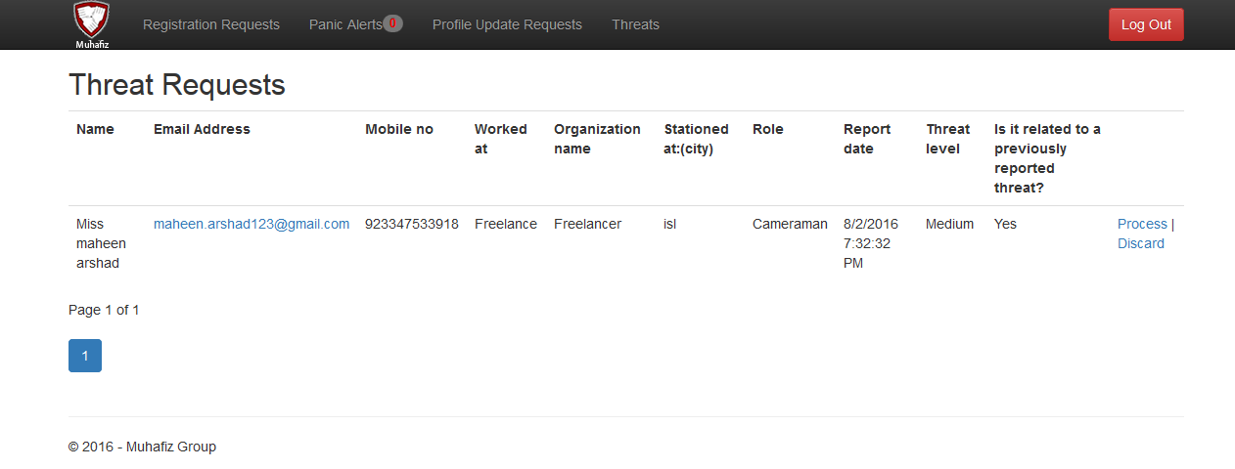
Threat Requests
View: GetAllThreatRequests.cshtml
AdminController: Action GetAllThreatRequests return list of all the threat Requests from
Database .
Action: Process and Discard
Model: ThreatReportViewModel.cs is coupled with this view that includes objects of
ThreatNotification.cs and cperson.cs

Slide 7
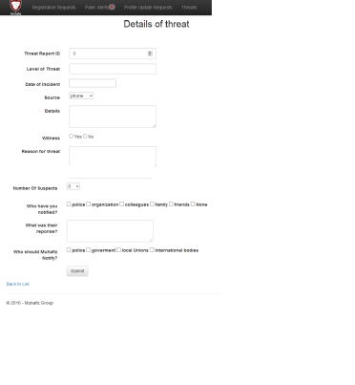
Process Threat
View: Process.cshtml
Admin Controller: Processs [Get] Action Displays that form for threat Details entries.
On submit form Process[Post] method is called which handle this action.
Model: ThreatViewModel is coupled with this view , that includes Threat.cs object,
ThreatDetails.cs, ThreatNotification.cs object.

